Slide 1
DaTa Structures
Arrays
By
Zainab Malik

Slide 2
Content
Concept of Arrays
Array Representation
Operations performed on arrays
Limitation of arrays
Application of linear Arrays

Slide 3
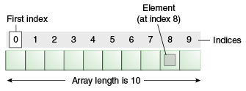
Arrays
A linear array is a list of finite number of homogeneous data elements such that
The elements of the array are referenced by an index set consisting of n consecutive integer numbers
The elements of the array are stored in consecutive memory locations

Slide 4
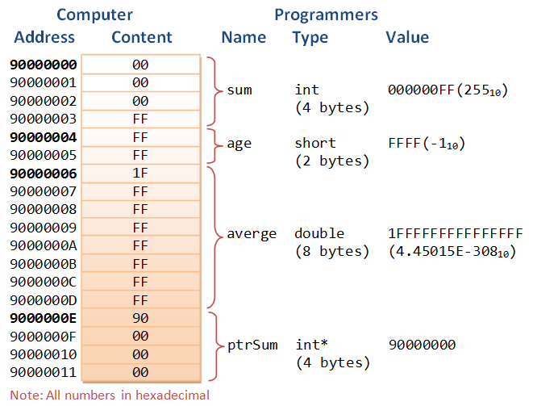
Array Representation in Memory
Memory of a computer system is simply a sequence of addressed location.
As arrays are stored in consecutive memory locations, the system need not to keep track of the address of every element of that array, but needs to keep the address of first element only (base address)

Slide 5
Array Representation in Memory
Address | Slot
1197 | 15
1198
1199 | 14
1200
1201 | 23
1202
1203 | 11
1204
1205 | 42
1206
1207
1208
1209
0 | 1 | 2 | 3 | 4
15 | 14 | 23 | 11 | 42
array
Loc (array[k])= base(array) + w* k
w is # of bytes per element
Loc(array[3])= 1197+2*2=1201

Slide 6
Operations performed on arrays
Traversal Operation
Searching Operation
Linear Search
Binary Search
Insertion Operation
Deletion Operation
Sorting Operation
Selection Sort
Bubble Sort
Insertion Sort
Merge Sort
Quick Sort etc.

Slide 7
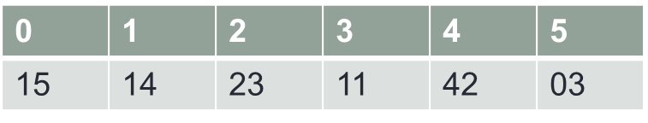
Traversal Operation
TraverseLinearArray(a, n)
Here a is a linear array of size n. This algorithm traverses the array and applies certain operation to each element of the array.
Set i=0 //Initialize counter
Repeat steps 3 and 4 while i<= (n-1)
Apply process (a[i]) //visit element
Set i=i+1 //increment counter
Endwhile
Exit

Slide 8
Searching

Slide 9
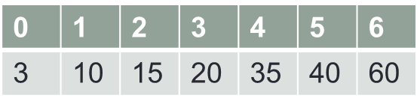
Searching Operation: Linear Search
LinearSearch(a, n, item, loc)
Here a is a linear array of size n. This algorithm finds the location of the item in linear array a. If search end in success it sets loc to the index of the element; otherwise it sets loc to -1.
Set i=0 //Initialize counter
Repeat steps 3 and 4 while i<= (n-1)
if(a[i]=item) then
Set loc=i //item found at location I
Exit
Endif
Set i=i+1 //increment counter
Endwhile
Set loc=-1 //item not found
Exit

Slide 10
Searching Operation: Binary Search
BinarySearch(a, n, item, loc)
Here a is a linear array of size n. This algorithm finds the location of the item in sorted (asdending) linear array a. If search end in success it sets loc to the index of the element; otherwise it sets loc to -1. here variables beg and end are used to keep track of the first and last element of the array and variable mid is used as index of the middle element of the array under consideration.
Set beg=0
Set end=n-1
Set mid= (beg+end)/2
Repeat steps 5 and 6 while ((beg ≤ end) && (a[mid] ≠ item))
if(item < a[mid]) then
Set end=mid-1
else
+
Set beg=mid+1
Endif
Set mid= (beg+end) /2 // shift mid
Endwhile
If( beg > end ) then
Set loc=-1 //item not found
Else
Set loc =mid //item found at mid
Endif
Exit

Slide 11
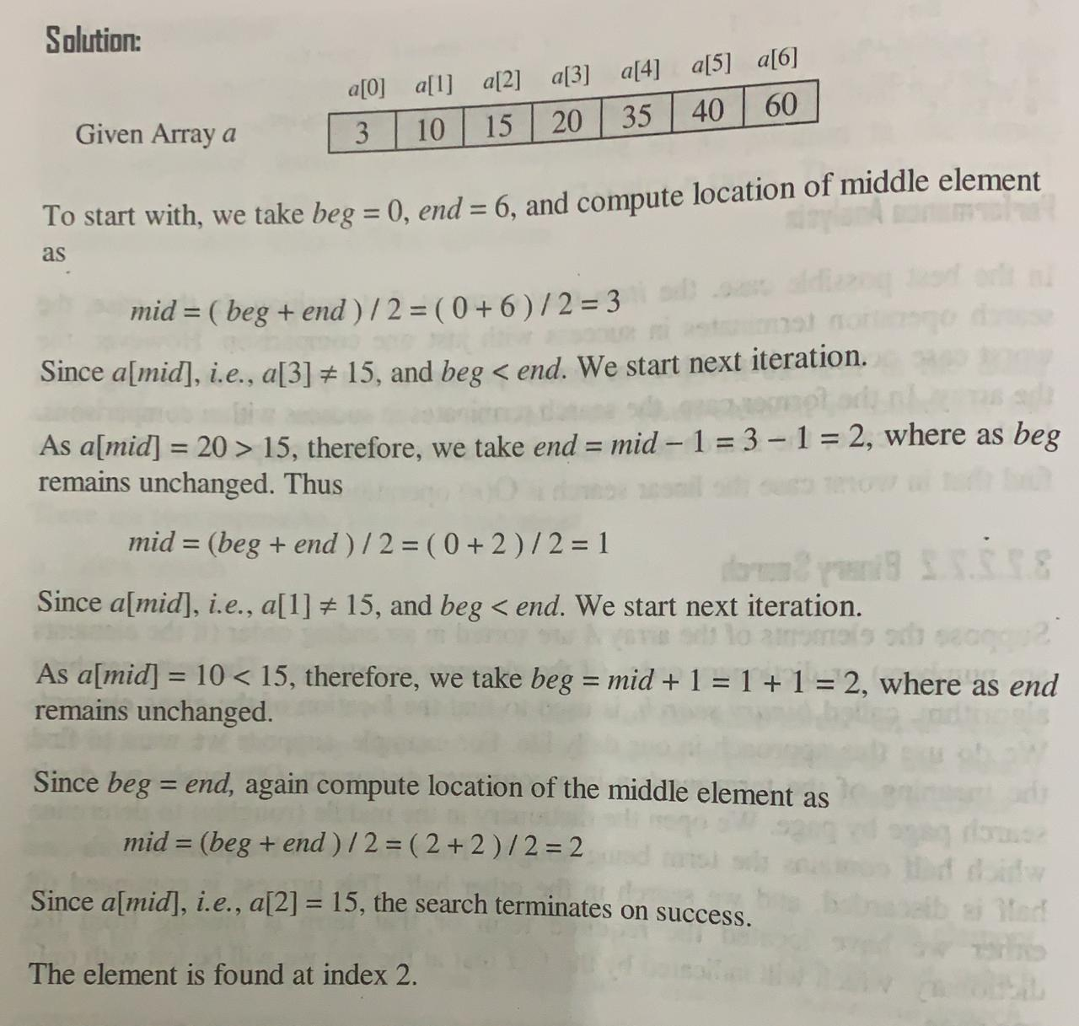
Searching Operation: Binary Search
0 | 1 | 2 | 3 | 4 | 5 | 6
3 | 10 | 15 | 20 | 35 | 40 | 60
0 | 1 | 2 | 3 | 4 | 5 | 6
3 | 10 | 15 | 20 | 35 | 40 | 60
0 | 1 | 2 | 3 | 4 | 5 | 6
3 | 10 | 15 | 20 | 35 | 40 | 60

Slide 12
Class Task
Write an algorithm to find the largest element in an array.

Slide 13
Sorting

Slide 14
Selection Sort
Algorithm:
Get a list of unsorted elements
Divide the list logically using a marker into two sub-lists: sorted and unsorted
Repeat Step 4-7 until one element is remain in unsorted list
Compare all elements in unsorted sublist
Select the largest element
Swap it with the element at the end of the unsorted list
Decrement the marker
Stop

Slide 15
Selection Sort
Sorted Sublist
Find Largest element in Unsorted List | 23 | 78 | 45 | 8 | 32 | 56
Swap with the Last Element of Unsorted List | 23 | 56 | 45 | 8 | 32 | 78
Find Largest element in Unsorted List | 23 | 56 | 45 | 8 | 32 | 78
Swap with the Last Element of Unsorted List | 23 | 32 | 45 | 8 | 56 | 78
Find Largest element in Unsorted List | 23 | 32 | 45 | 8 | 56 | 78
Swap with the Last Element of Unsorted List | 23 | 32 | 8 | 45 | 56 | 78
Find Largest element in Unsorted List | 23 | 32 | 8 | 45 | 56 | 78
Swap with the Last Element of Unsorted List | 23 | 8 | 32 | 45 | 56 | 78
Find Largest element in Unsorted List | 23 | 8 | 32 | 45 | 56 | 78
Swap with the Last Element of Unsorted List | 8 | 23 | 32 | 45 | 56 | 78
Find Largest element in Unsorted List | 8 | 23 | 32 | 45 | 56 | 78
Swap with the Last Element of Unsorted List | 8 | 23 | 32 | 45 | 56 | 78

Slide 16
Bubble Sort
Algorithm:
Get a list of unsorted elements
Divide the list logically using a marker into two sub-lists: sorted and unsorted
Repeat Step 4-5 until one element is remain in unsorted list
The largest element is bubbled from the unsorted list and move to the sorted list
Decrement the marker
Stop

Slide 17
Bubble Sort
Comparison Sorted Sublist
Step 4 | 23 | 78 | 45 | 8 | 32 | 56
Step 4 | 23 | 78 | 45 | 8 | 32 | 56
Step 4 | 23 | 45 | 78 | 8 | 32 | 56
Step 4 | 23 | 45 | 8 | 78 | 32 | 56
Step 4 | 23 | 45 | 8 | 32 | 78 | 56
Step5 | 23 | 32 | 8 | 45 | 56 | 78
Step 4 | 23 | 32 | 8 | 45 | 56 | 78
Step 4 | 23 | 32 | 8 | 45 | 56 | 78
Step 4 | 23 | 8 | 32 | 45 | 56 | 78
Step 4 | 8 | 23 | 32 | 45 | 56 | 78
Step5 | 8 | 23 | 32 | 45 | 56 | 78
Step 4 | 8 | 23 | 32 | 45 | 56 | 78
Step 4 | 8 | 23 | 32 | 45 | 56 | 78
Step 4 | 8 | 23 | 32 | 45 | 56 | 78
Step 5 | 8 | 23 | 32 | 45 | 56 | 78
Step 4 | 8 | 23 | 32 | 45 | 56 | 78
Step 4 | 8 | 23 | 32 | 45 | 56 | 78
Step5 | 8 | 23 | 32 | 45 | 56 | 78
Step 4 | 8 | 23 | 32 | 45 | 56 | 78
Step 5 | 8 | 23 | 32 | 45 | 56 | 78
Step 4 | 8 | 23 | 32 | 45 | 56 | 78
Comparison
Sorted Sublist

Slide 18
Insertion Sort
Task 1: Understand the procedure of Insertion sort by performing dry-run
Task 2: Implement Insertion Sort

Slide 19
Thank You

